Slide 1



ASP.NET Razor Engine
ASP.NET MVC
Introduction
SoftUni Team
Technical Trainers
Software University
http://softuni.bg

Slide 2
Have a Question?
sli.do #CSharpWeb

Slide 3
Table of Contents
Razor HTML helpers
Model validations

Slide 4
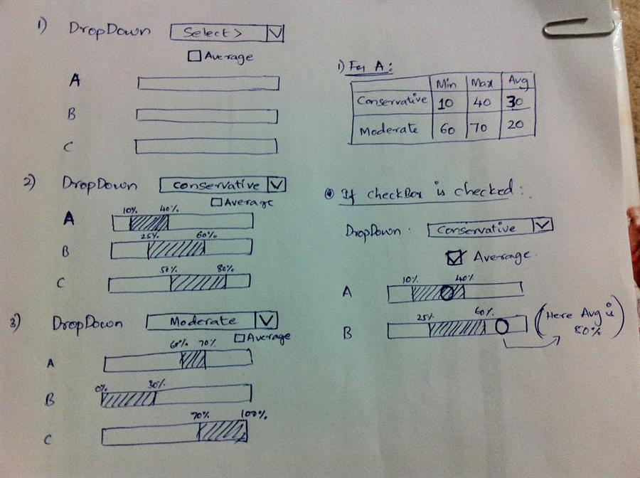
Advanced Razor Syntax

Slide 5
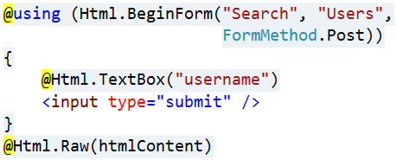
View Helpers
Each view inherits WebViewPage
ViewPage has a property named Html
Html property has methods that return string and can be used to generate HTML
Create inputs
Create links
Create forms
Other helper properties are also available
Ajax, Url, custom helpers

Slide 6
Common HTML Helpers
HTML Helper | Description
@HTML.ActionLink | Returns and anchor link
@using (Html.BeginForm) { form content } | Creates and html form
@HTML.CheckBoxFor | Creates a checkbox for a given property of the model
@HTML.Display\For | Displays the name of a given property
@HTML.Editor\For | Creates and editor\for a given property
@HTML.Label\For | Creates a label\for the given property

Slide 7
Other HTML Form Helpers
HTML Helper
@Html.DropDownList\For
@Html.TextBox\For
@Html.TextArea\For
@Html.Password\For
@Html.Hidden\For
@Html.CheckBox\For
@Html.RadioButton\For
@Html.ListBox\For

Slide 8
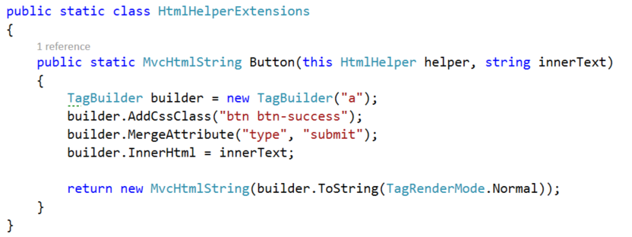

Custom Helpers
Write extension methods for the HtmlHelper
Return a string or override the ToString() method
The TagBuilder class manages closing tags and attributes
Add namespace in web.config (if needed)

Slide 9

Data Validation

Slide 10
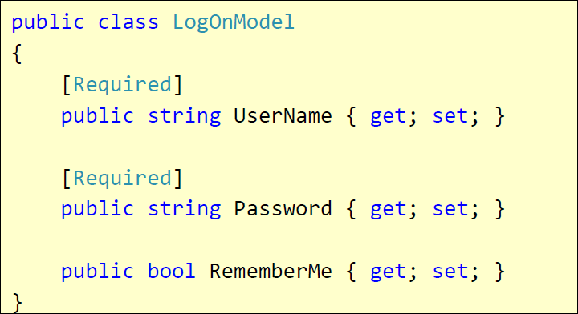
Validation with Annotations
Attributes are defined in
System.ComponentModel.DataAnnotations
Covers common validation patterns
Required
StringLength
Regex
Range

Slide 11
Data Validation Attributes
Attribute | Description
Required | Checks whether a non-null value is assigned to the property. It can be configured to fail if an empty string is assigned.
StringLength | Checks whether the string is longer than the specified value.
Compare | Checks whether two specified properties in the model have the same value.
Range | Checks whether the value falls in the specified range. It defaults to numbers, but it can be configured to consider a range of dates, too.
RegularExpression | Checks whether the value matches the specified expression.
CustomValidation | Checks the value against the specified custom function.

Slide 12
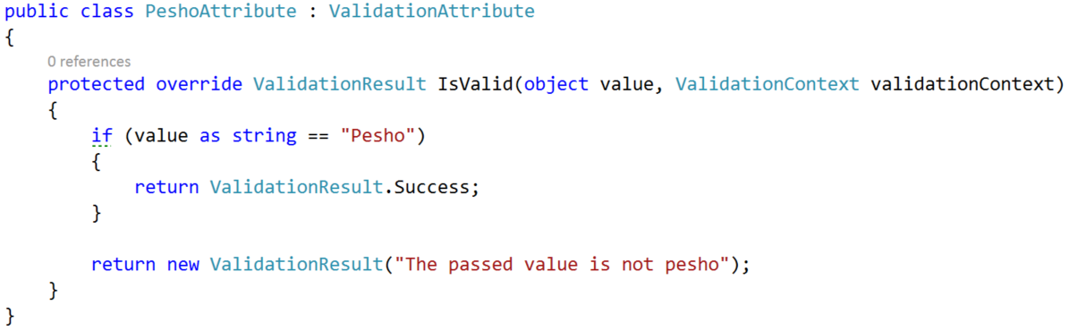
Custom Validation
Custom attributes
Inherit ValidationAttribute

Slide 13
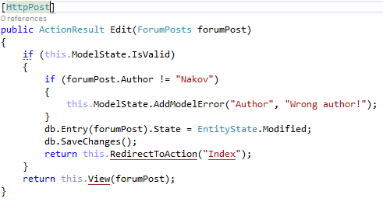
Validating Model – Controller
ModelState.IsValid will give us information about the data validation success
ModelState.AddModelError() will produce a custom error

Slide 14
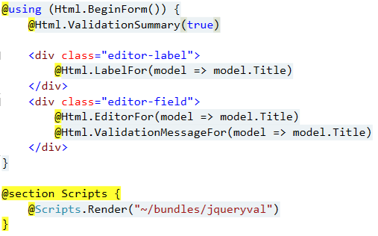
Validating Model – View
@Html.ValidationSummary() – output errors
@Html.ValidationMessageFor(…) – outputs validation message for specified property
Text box with integrated client-side validation
jQuery validation library required for unobtrusive JavaScript validation
P.S. Check Web.config

Slide 15
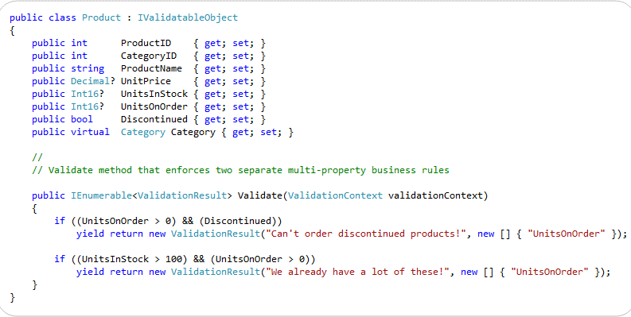
Class-Level Model Validation
Your model should implemented IValidatableObject
From now on, MVC (works with EF too) will validate the object by your custom rules

Slide 16
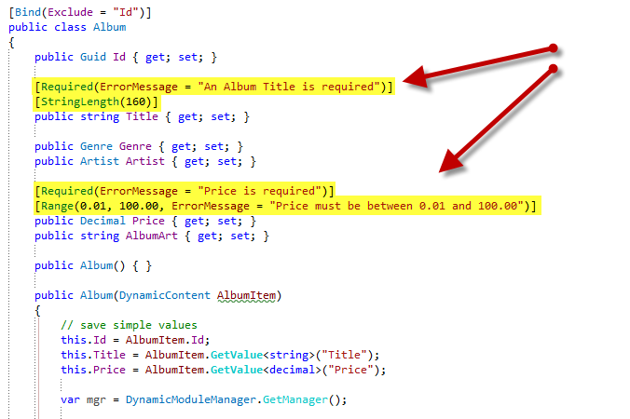
Other Annotations

Slide 17
Display / Edit Annotations
Attribute | Description
DisplayName | Friendly name for labels
DisplayFormat | Format strings and null display text
DisplayColumn | Specify the property of a model class for simple text display.
HiddenInput | Render value in a hidden input (when editing).
Bind | Tells the model binder which properties to include/exclude

Slide 18








ASP.NET Razor Engine
https://softuni.bg/courses/

Slide 19
License
This course (slides, examples, demos, videos, homework, etc.) is licensed under the "Creative Commons Attribution-NonCommercial-ShareAlike 4.0 International" license

Slide 20






Free Trainings @ Software University
Software University Foundation – softuni.org
Software University – High-Quality Education, Profession and Job for Software Developers
softuni.bg
Software University @ Facebook
facebook.com/SoftwareUniversity
Software University @ YouTube
youtube.com/SoftwareUniversity
Software University Forums – forum.softuni.bg

